Slide 1
Predictive Modeiing of Piant Diseases Using Machine Learning
Exploring Machine Learning Techniques for Enhancing Agricultural Productivity
Preenter
^œn'ea 1°nç
preseutotions

Slide 2

Understanding the Challenge: Plant Diseases
Significant Impact on Agriculture and Economy
^œn'ea 1°nç
preseutotions

Slide 3
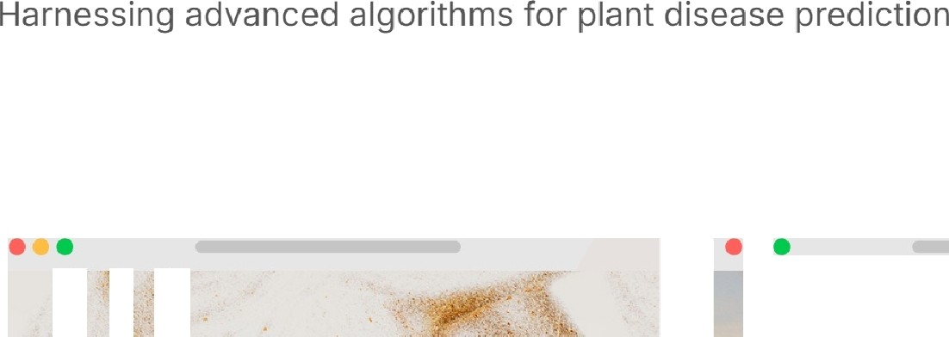

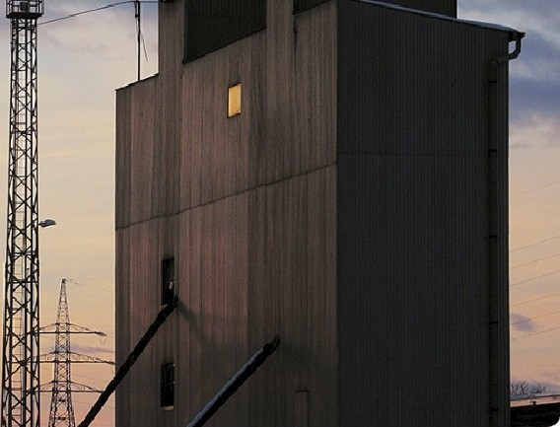

Machine Learning Techniques in Focus
3
Convolutional Neural Networks (CNNs)
H iphly effective for imape-based disease detection, CNNs analy ze visual data to identify plant ailments.
Support Vector Machines (SVMs)
I deal for c lassification tasks, SVMs excel in dishing uishing between healthy and diseased plants based on diverse features.
Random Forests
Random Forests enhance accuracy in disease prediction by aggregating decisions from multiple decision trees.
^œn'ea 1°nç
preseutotions

Slide 4





Datasets Utilized: A Closer Look
Exploring Open-Source Datasets for Plant Disease Prediction
Open-Source Datasets
Utilized open-source datasets to enhance accessibility and collaboration.
PlantVillage Dataset
PlantVillage offers thousands of labeled images crucial for model training.
Training and Testing
Datasets facilitate both training and testing phases of machine learning models.
Labeled Images
Thousands of labeled images include both healthy and diseased plants.
Model Validation
Data sets are essential for validating the accuracy of predictive models.
^œn'ea 1°nç
preseutotions

Slide 5
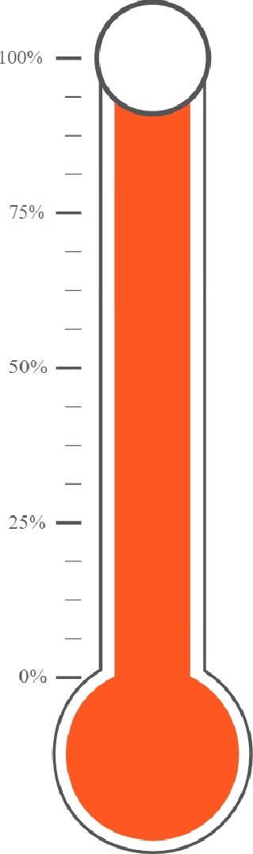
Results and
Model Accuracy
95
Model A
Achieving 95% Accuracy in Plant Disease Prediction Using Machine Learning
^œn'ea 1°nç
preseutotions

Slide 6

Case Study: Apple Scab Detection
Exploring the Efficacy of Neural Networks in Plant Disease Prediction
High Accuracy in Disease Detection
Neural networks reached 95% accuracy in detecting apple scab, highlighting their efiectiveness.
^œn'ea 1°nç
preseutotions

Slide 7
Blue River Technology's 'See & Spray'
This technology significantly reduces herbicide use by 90%, promoting sustainable farming.
Success Stories in AI- Driven Agriculture
Innovative solutions transforming plant disease prediction and management
AgriBot
Achieves over 90% success in plant classification and weeding,
enhancing efficiency.
Drone-Assisted Surveillance
Improves crop management and lowers environmental impact through precise monitoring.
^œn'ea 1°nç
preseutotions

Slide 8





Future Directions in Machine Learning
Advancing Predictive Modeling for Plant Disease Detection
Improve model accuracy and robustness.
Focus on refining algorithms to achieve higher precision in predictions.
O Integrate real-time
disease detection
systems.
Develop systems that provide immediate alerts for plant diseases using ML.
Expand model
O
applications to include a
wider variety of crops.
Broaden the scope of models to enhance their utility across different crop types.
^œn'ea 1°nç
preseutotions

Slide 9

Conciusion: The Road
Ahead
Leveraging Machine Learning for Sustainable Agriculture and Crop Health

Slide 10

Caii to Action:
Embrace Technoiogy
Join forces to revolutionize agriculture with machine learning for plant disease prediction.

